Slide 1
GloBox A/B Test Results

Slide 2
Overview and limitations
Test was conducted over a period of 13 days
Jan 25th to Feb 6th
Only data from the mobile site was captured
There is no distinction in the type of product purchased
Going forward, note that Group A is the Control Group
Group B is the Treatment Group
Group A contains a total of 24,343 users
Group B contains a total of 24,600 users

Slide 3
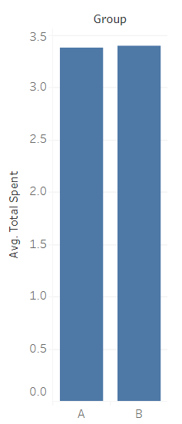
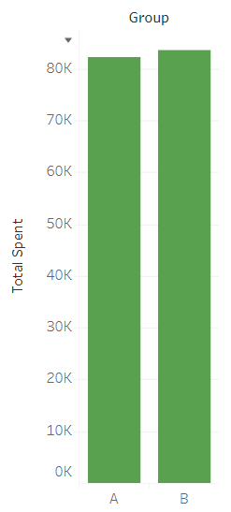
Spending
Group A spent a total of 82,145.90$
With an average of 3.37$ spent per user
Group B spent a total of 83,415.33$
With an average of 3.39$ spent per user
As you can see, the values are close.
This is not a significant difference between the two.

Slide 4
Conversion
Total conversions for both groups combined is 2094
Total test population is 48,943
This represents a total of 4.28%
Group A has 955 conversions
This represents 45.61% of conversions
Group B has 1139 conversions
This represents 54.39% of conversions

Slide 5
Information of Interest
Women were the highest spenders
This applies both in total, and on average
Android users made up the largest portion of devices
Despite this, iOS were the highest spenders on average

